Slide 1
Is Paid Family Leave What’s Next for Michigan?
Michigan Children’s Lunch and Learn
Sept. 20, 2023

Slide 2
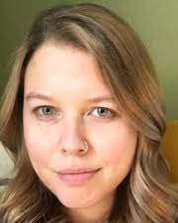
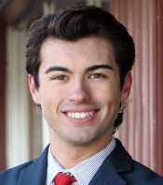
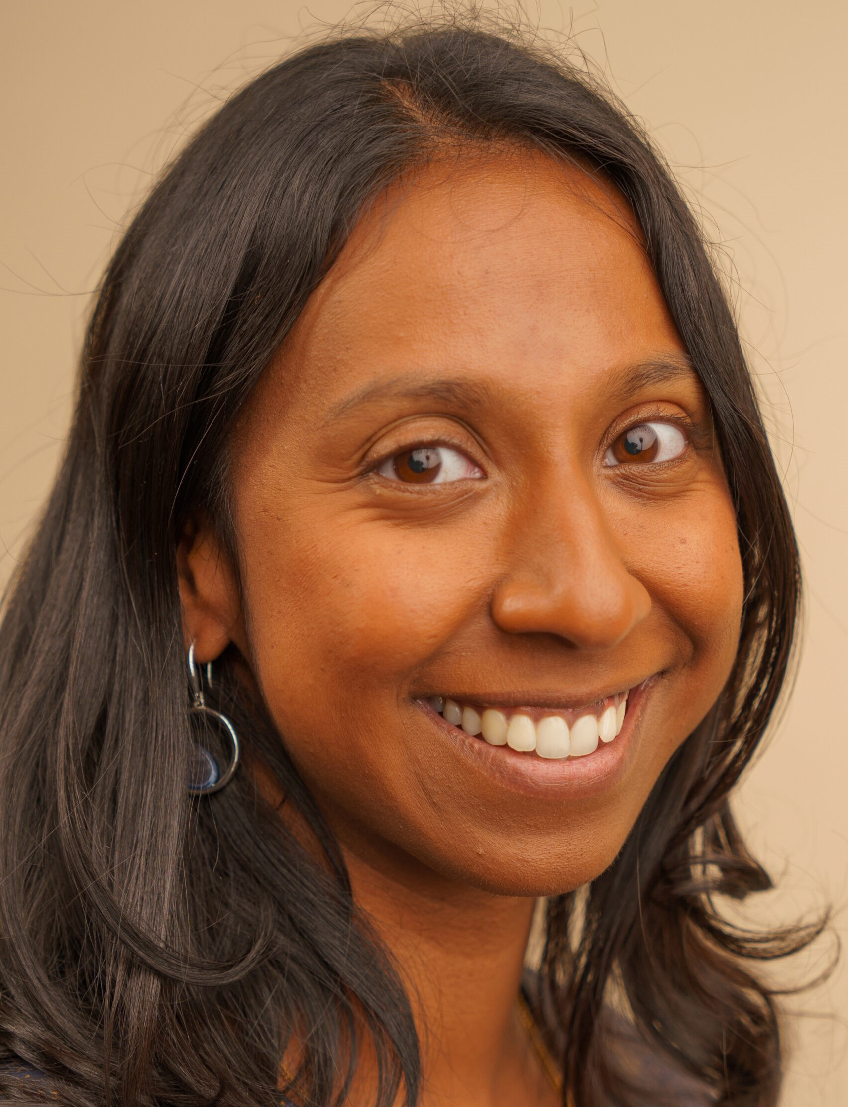
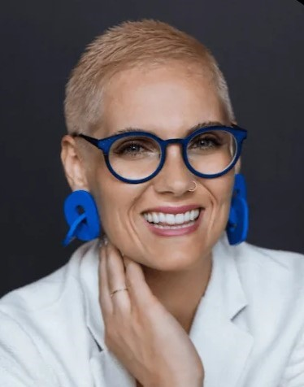
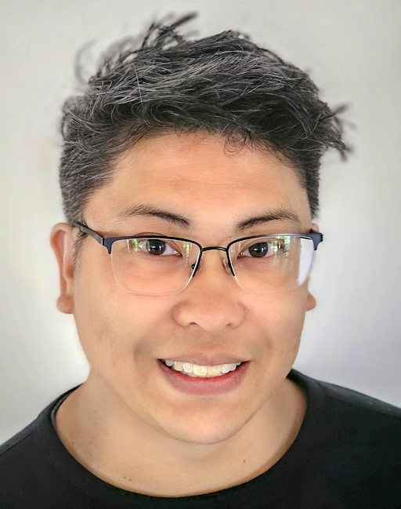
Our Guests and Panelists
Rep. Jasper Martus
Julianna Carlson
Jaimie Worker Hanna Schultze Christian Ko

Slide 3
Our Agenda
Welcome: Teri Banas, Director for Programs and Communications, Michigan’s Children
Guests: Jaimie Worker, Assoc. Director, Policy & Advocacy, Caring Across Generations
Julianna Carlson, Research Scientist, Child Trends
State Rep. Jasper Martus, D-Flushing, Michigan Legislature
Hanna Schulze, President, People First Economy, Grand Rapids
Christian Ko, Co-Chair, Think Babies Michigan
Presentations:
Julianna Carlson: “Recommendations for Creating Equitable and Inclusive Paid Family Leave Policies”:
State Rep. Jasper Martus: “Capitol Update Status of Family and Medical Leave
Legislation”
Panelists Roundtable Discussion: Matt Gillard, President & CEO, Michigan’s Children

Slide 4
Research Scientist Julianna Carlson, Child Trends
“Recommendations for Creating Equitable and Inclusive
Paid Family Leave Policies”

Slide 5
Recommendations
Paid parental leave policies should:
Have inclusive definitions of families and workers
Adequately reimburse workers’ wages
Provide at least 12 weeks of leave
Ensure job protection for all workers taking leave
Be funded and implemented in a way that advances equity
Include outreach and communication plans

Slide 6
State Rep. Jasper Martus, D-Flushing
“Capitol Update: Status of Family and Medical Leave Legislation”

Slide 7
Overview: Efforts of National and State-based organizations and the Coalition that’s heading the charge for a mandatory paid family and medical leave plan in Michigan.
Jaimie Worker of Caring Across Generations, and Hanna Schulze of First Economy of Grand Rapids discuss the Coalition efforts underway.
Parent Perspective: Christian Ko of Think Babies Michigan
And what parents of young families are saying around the state.

Slide 8
Panel Talk with Matt Gillard
Q. Has the time come for a mandatory statewide plan for paid family leave in Michigan? Why?
Q. Strongest arguments in favor?
Q. How can ordinary residents and activists get involved?
Q. Suggestions for reaching out to urge and support action by state Legislators and specifically Democratic leadership in the House?
Q. What else can we do?
Q. new
Q. new
Q. What can we do? Suggestions for advocacy?

Slide 9
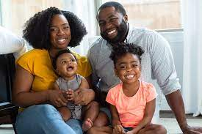
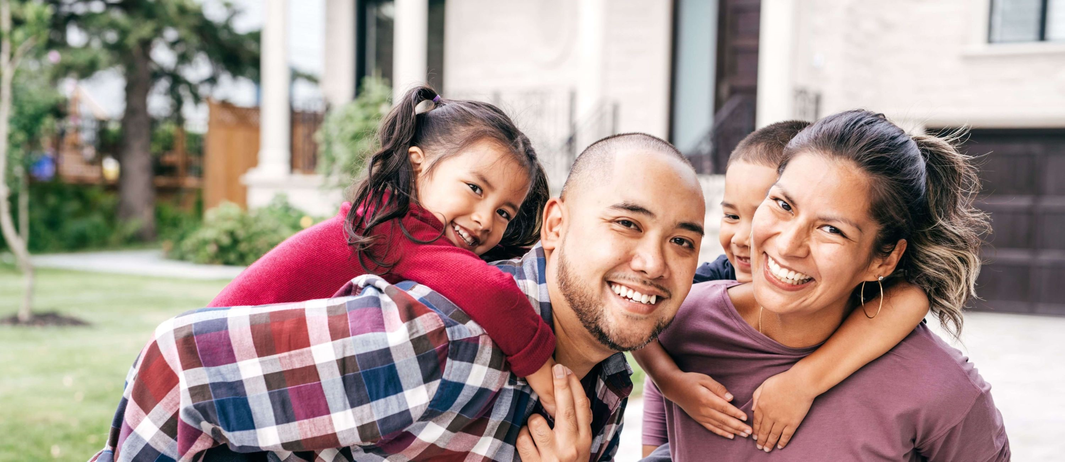
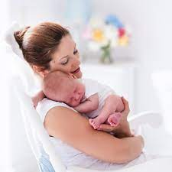
Call to Action:
What can you do start today to ensure
that all families have access to paid
family and medical leave in Michigan?

Slide 10
In Closing:
Look for resources & panelist bios on the Lunch & Learn page under Resources at www.Michiganschildren.org
Join us for our next Lunch & Learn on Wednesday, October 19
Watch/listen to our next Podcast episode of Speaking for Kids!
Sign up to receive our bulletin at www.Michiganschildren.org

